Slide 1
Group: #3
Group member’s name:
Chor visalrotanak
Kim Theara
Yanty
Long
Daro
Sotherny

Slide 2
Characteristic of Nonverbal Communication

Slide 3
Content:
Definition.
Type of characteristic of nonverbal communication.
Conclusion.
References.

Slide 4

Definition
What is characteristic of nonverbal communication?

Slide 5
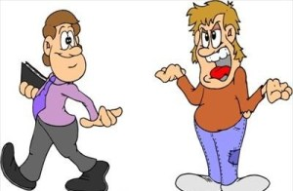
Type of characteristic of nonverbal communication.
Intentional and Unintentional

Slide 6

Primary
Nonverbal communication is More believable than verbal communication

Slide 7

multichannel
Nonverbal communication is multichannel since we use variety of used to make an interpretation.

Slide 8
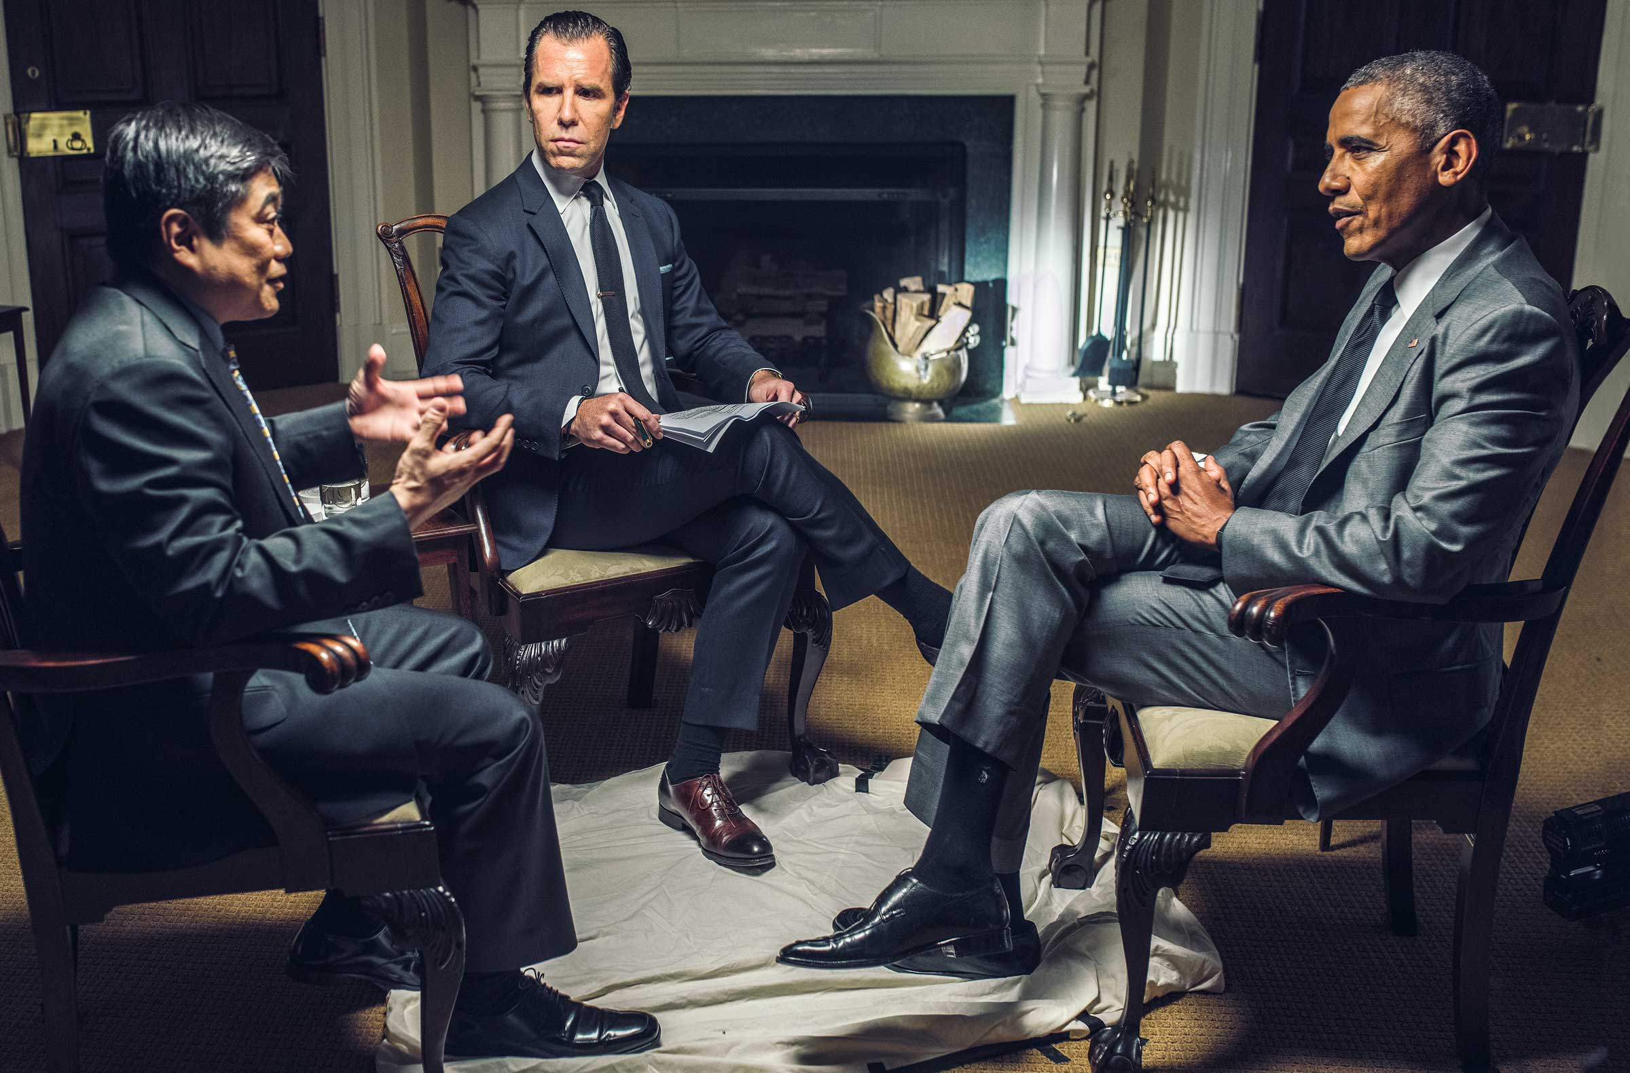
Occur constantly.
Nonverbal communication is continuous, because one is constantly communication through nonverbal behavior.
Like we have to communication by using facial expression, or body language that make other person know how you care about the conversation.

Slide 9

Ambiguous
Ambiguous refer to having more than one possible meaning and depending on the user’s personality.

Slide 10

Conclusion.

Slide 11
Reference.
https://slideplayer.com/slide/5911546
https://www.ukessays.com
https://www.verywellmind.com/types-of-nonverbal-communication
https://www.helpguide.org/articles/relationship-communication/nonverbal

Slide 12


